Slide 1
Lecture 5: Unsupervised Learning
Olexandr Isayev
Department of Chemistry, CMU
olexandr@cmu.edu

Slide 2
Plan for the lecture
HW1: Discussion is on Thursday
HW2: Clustering
Select your class final project problems:
Upload title and one paragraph summary
I encourage you to use your domain-specific dataset
If not, I am happy to give you one

Slide 3
Machine Learning
Supervised: We are given input samples (X) and output samples (y) of a function y = f(X). We would like to “learn” f, and evaluate it on new data. Types:
Classification: y is discrete (class labels).
Regression: y is continuous, e.g. linear regression.
Unsupervised: Given only samples X of the data, we compute a function f such that y = f(X) is “simpler”.
Clustering: y is discrete
Y is continuous: Matrix factorization, Kalman filtering, unsupervised neural networks.

Slide 4
Supervised learning vs. unsupervised learning
Supervised learning: discover patterns in the data that relate data attributes with a target (class) attribute.
These patterns are then utilized to predict the values of the target attribute in future data instances.
Unsupervised learning: The data have no target attribute.
We want to explore the data to find some intrinsic structures in them.

Slide 5
Clustering
Clustering is a technique for finding similarity groups in data, called clusters. I.e.,
it groups data instances that are similar to (near) each other in one cluster and data instances that are very different (far away) from each other into different clusters.
Clustering is often called an unsupervised learning task as no class values denoting an a priori grouping of the data instances are given, which is the case in supervised learning.
Due to historical reasons, clustering is often considered synonymous with unsupervised learning.
In fact, association rule mining is also unsupervised
This lecture focuses on clustering.

Slide 6
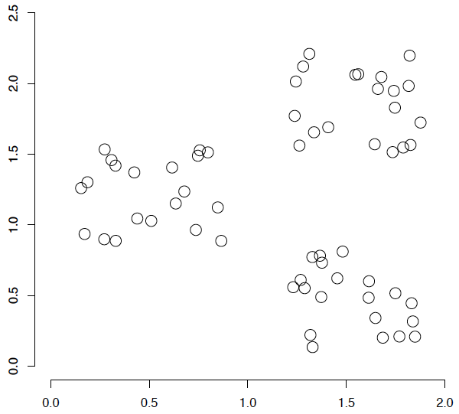
An illustration
The data set has three natural groups of data points, i.e., 3 natural clusters.
How would you design an algorithm for finding the three clusters in this case?

Slide 7
Classification vs. Clustering
Classification: supervised learning
Clustering: unsupervised learning
Classification: Classes are human-defined and part of the input to the learning algorithm.
Clustering: Clusters are inferred from the data without human input.
However, there are many ways of influencing the outcome of clustering: number of clusters, similarity measure, representation of molecules, . . .
7

Slide 8
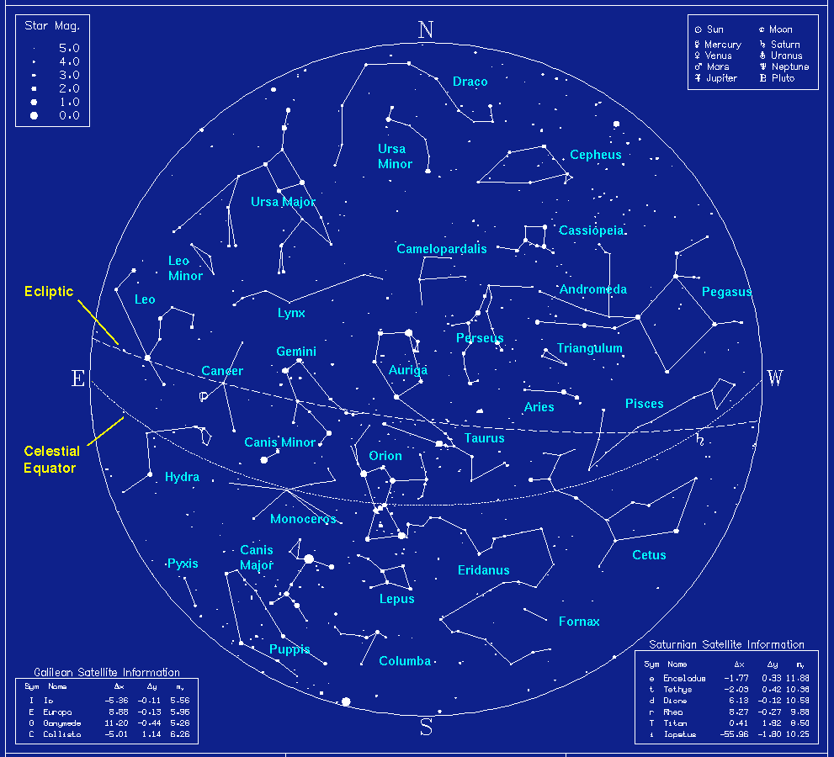
Cluster Bias

Slide 9
Aspects of clustering
A clustering algorithm
Partitional clustering
Hierarchical clustering
…
A distance (similarity, or dissimilarity) function
Clustering quality
Inter-clusters distance ⇒ maximized
Intra-clusters distance ⇒ minimized
The quality of a clustering result depends on the algorithm, the distance function, and the application.

Slide 10
Issues for clustering
Sec. 16.2
Representation for clustering
Data representation
Vector space? Normalization?
Need a notion of similarity/distance
How many clusters?
Fixed a priori?
Completely data driven?
Avoid “trivial” clusters - too large or small
If a cluster's too large, then for navigation purposes you've wasted an extra time

Slide 11
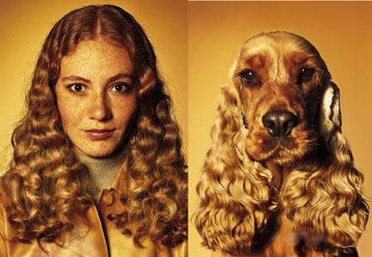
What is Similarity?
The quality or state of being similar; likeness; resemblance; as, a similarity of features.
Webster's Dictionary
Similarity is hard to define, but…
“We know it when we see it”
The real meaning of similarity is a philosophical question. We will take a more pragmatic approach.

Slide 12
Notion of similarity/distance
Depending on the type of data – different distance/metric is used
Euclidean
Cosine similarity, Manhattan Distance, Jaccard
Tanimoto similarity

Slide 13
Intuitions behind desirable distance measure properties
D(A,B) = D(B,A) Symmetry
Otherwise you could claim “Alex looks like Bob, but Bob looks nothing like Alex.”
D(A,A) = 0 Constancy of Self-Similarity
Otherwise you could claim “Alex looks more like Bob, than Bob does.”
D(A,B) = 0 If A=B Positivity (Separation)
Otherwise there are objects in your world that are different, but you cannot tell apart.
D(A,B) ≤ D(A,C) + D(B,C) Triangular Inequality
Otherwise you could claim “Alex is very like Bob, and Alex is very like Carl, but Bob is very unlike Carl.”

Slide 14
Terminology
Hierarchical clustering: clusters form a hierarchy. Can be computed bottom-up or top-down.
Flat clustering: no inter-cluster structure.
Hard clustering: items assigned to a unique cluster.
Soft clustering: cluster membership is a real-valued function, distributed across several clusters.

Slide 15
Clustering Algorithms
Flat algorithms
Usually start with a random (partial) partitioning
Refine it iteratively
K means clustering
(Model based clustering)
Hierarchical algorithms
Bottom-up, agglomerative
(Top-down, divisive)

Slide 16
Hard vs. soft clustering
Hard clustering: Each sample belongs to exactly one cluster
More common and easier to do
Soft clustering: A sample can belong to more than one cluster.
Makes more sense for applications like creating browsable hierarchies
You may want to put a pair of sneakers in two clusters: (i) sports apparel and (ii) shoes
You can only do that with a soft clustering approach.

Slide 17

K-means
Each cluster in K-means is defined by a centroid.
Objective/partitioning criterion: minimize the average squared difference from the centroid
Recall definition of centroid:
where we use ω to denote a cluster.
We try to find the minimum average squared difference by iterating two steps:
reassignment: assign each vector to its closest centroid
recomputation: recompute each centroid as the average of the vectors that were assigned to it in reassignment

Slide 18
K-means clustering
The standard k-means algorithm is based on Euclidean distance.
The cluster quality measure is an intra-cluster measure only, equivalent to the sum of item-to-centroid kernels.
A simple greedy algorithm locally optimizes this measure (usually called Lloyd’s algorithm):
Find the closest cluster center for each item, and assign it to that cluster.
Recompute the cluster centroid as the mean of items, for the newly-assigned items in the cluster.

Slide 19
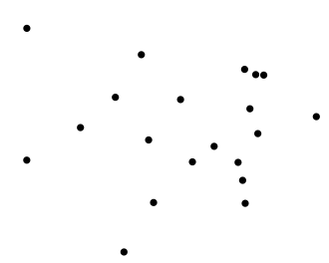
Worked Example: Set of to be clustered

Slide 20
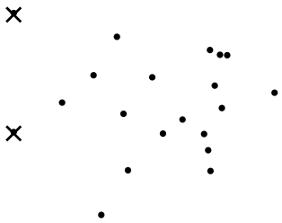
Worked Example: Random selection of initial
centroids
Exercise:
Guess what the optimal clustering into two clusters is in this case;
compute the centroids of the clusters

Slide 21
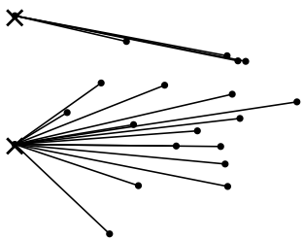
Worked Example: Assign points to closest center

Slide 22
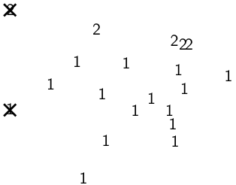
Worked Example: Assignment

Slide 23
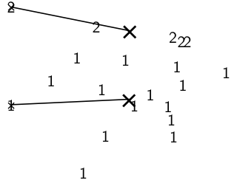
Worked Example: Recompute cluster centroids

Slide 24
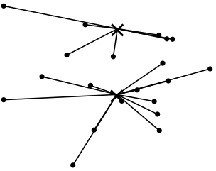
Worked Example: Assign points to closest centroid

Slide 25
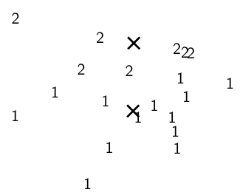
Worked Example: Assignment

Slide 26
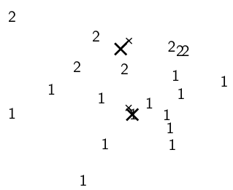
Worked Example: Recompute cluster centroids

Slide 27
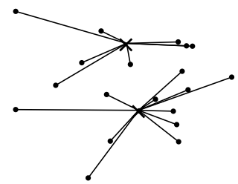
Worked Example: Assign points to closest centroid

Slide 28
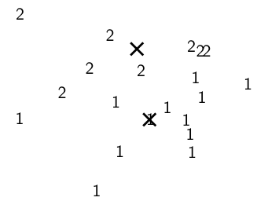
Worked Example: Assignment

Slide 29
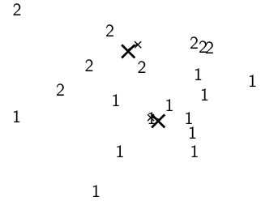
Worked Example: Recompute cluster centroids

Slide 30
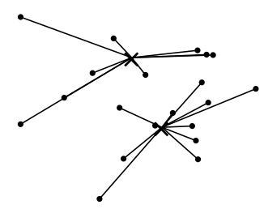
Worked Example: Assign points to closest centroid

Slide 31
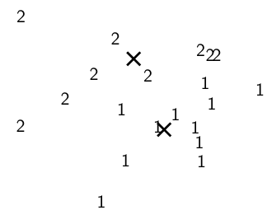
Worked Example: Assignment

Slide 32
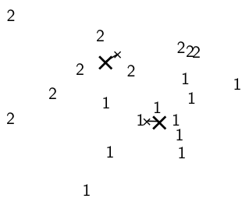
Worked Example: Recompute cluster centroids

Slide 33
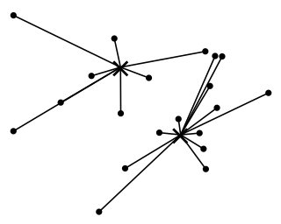
Worked Example: Assign points to closest centroid

Slide 34
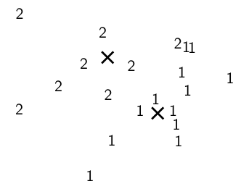
Worked Example: Assignment

Slide 35
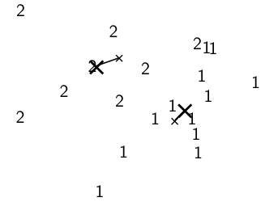
Worked Example: Recompute cluster centroids

Slide 36
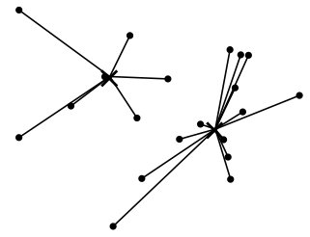
Worked Example: Assign points to closest centroid

Slide 37
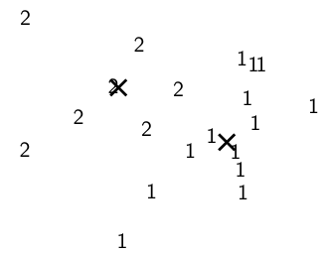
Worked Example: Assignment

Slide 38
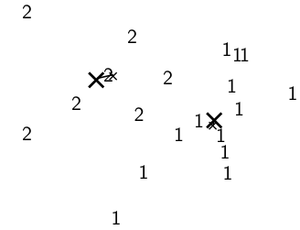
Worked Example: Recompute cluster centroids

Slide 39
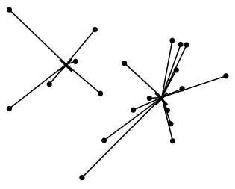
Worked Example: Assign points to closest centroid

Slide 40
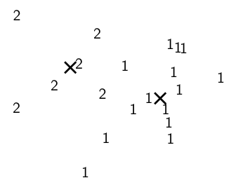
Worked Example: Assignment

Slide 41
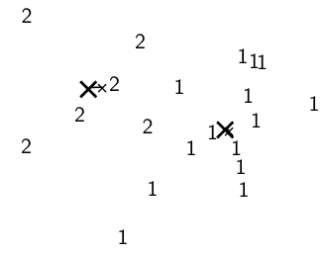
Worked Example: Recompute cluster centroids

Slide 42
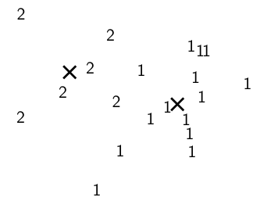
Worked Ex.: Centroids and assignments after convergence

Slide 43
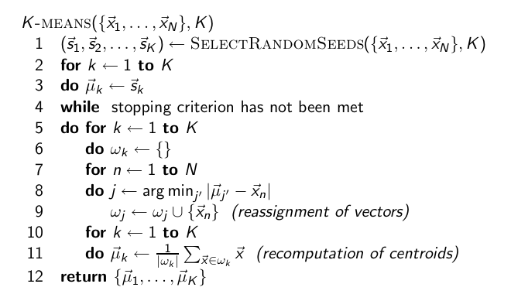
K-means algorithm

Slide 44
K-means is guaranteed to converge
RSS = sum of all squared distances between document vector and closest centroid
RSS decreases during each reassignment step.
because each vector is moved to a closer centroid
RSS decreases during each recomputation step.
see next slide
There is only a finite number of clusterings.
Thus: We must reach a fixed point.
Assumption: Ties are broken consistently.
44

Slide 45
K-means is guaranteed to converge
But we don’t know how long convergence will take!
If we don’t care about a few points switching back and forth, then convergence is usually fast (< 10-20 iterations).
However, complete convergence can take many more iterations.
45

Slide 46
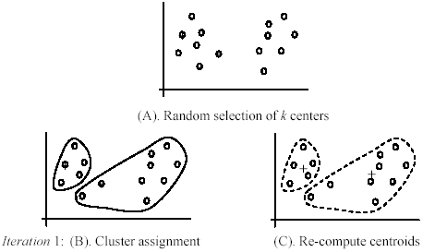
An example
+
+

Slide 47
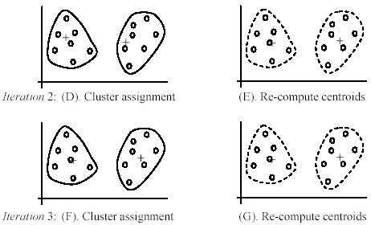
An example (cont …)

Slide 48
Strengths of k-means
Strengths:
Simple: easy to understand and to implement
Efficient: Time complexity: O(tkn),
where n is the number of data points,
k is the number of clusters, and
t is the number of iterations.
Since both k and t are small. k-means is considered a linear algorithm.
K-means is the most popular clustering algorithm.
Note that: it terminates at a local optimum if RSS is used. The global optimum is hard to find due to complexity.

Slide 49
Weaknesses of k-means
The algorithm is only applicable if the mean is defined.
For categorical data, k-mode - the centroid is represented by most frequent values.
The user needs to specify k.
The algorithm is sensitive to outliers
Outliers are data points that are very far away from other data points.
Outliers could be errors in the data recording or some special data points with very different values.

Slide 50
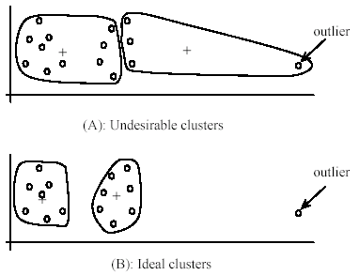
Weaknesses of k-means: Problems with outliers

Slide 51
Weaknesses of k-means: To deal with outliers
One method is to remove some data points in the clustering process that are much further away from the centroids than other data points.
To be safe, we may want to monitor these possible outliers over a few iterations and then decide to remove them.
Another method is to perform random sampling. Since in sampling we only choose a small subset of the data points, the chance of selecting an outlier is very small.
Assign the rest of the data points to the clusters by distance or similarity comparison, or classification

Slide 52
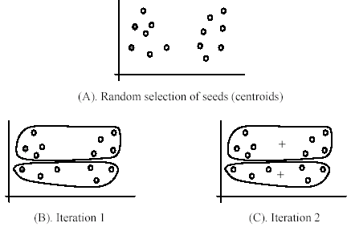
Weaknesses of k-means (cont …)
The algorithm is sensitive to initial seeds.

Slide 53
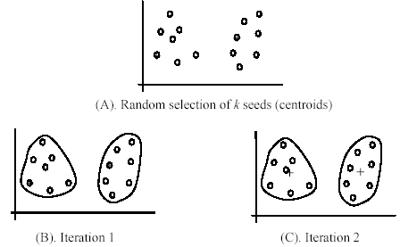
Weaknesses of k-means (cont …)
If we use different seeds: good results
There are some methods to help choose good seeds

Slide 54
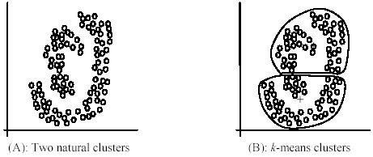
Weaknesses of k-means (cont …)
The k-means algorithm is not suitable for discovering clusters that are not hyper-ellipsoids (or hyper-spheres).
+

Slide 55
K-means Initialization
We need to pick some points for the first round of the algorithm:
Random sample: Pick a random subset of k points from the dataset.
K-Means++: Iteratively construct a random sample with good spacing across the dataset.
Note: Finding an exactly-optimal k-Means clustering is NP-hard. Randomization helps avoid bad configurations.

Slide 56
K-means++
Start:
Choose first cluster center at random from the data points
Iterate:
For every remaining data point x, compute D(x) the distance from x to the closest cluster center.
Choose a remaining point x randomly with probability proportional to D(x)², and make it a new cluster center.
Intuitively, this finds a sample of widely-spaced points avoiding “collapsing” of the clustering into a few internal centers.

Slide 57
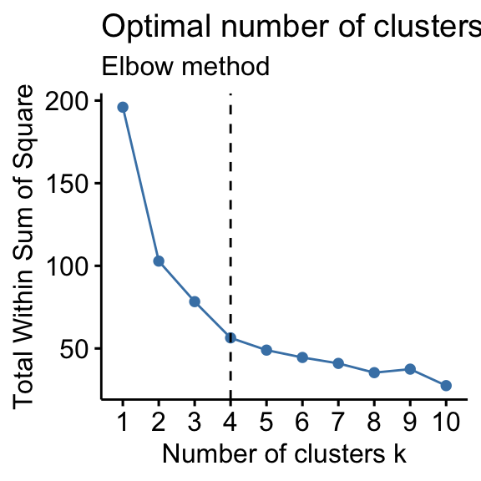
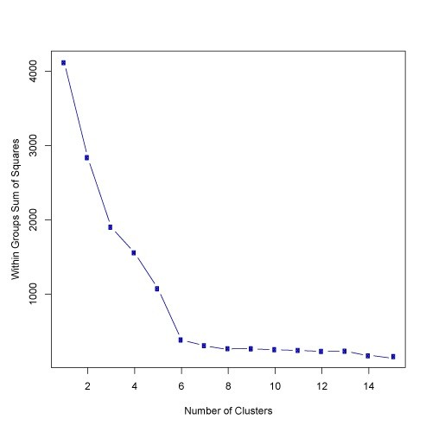

Slide 58
K-means properties
It’s a greedy algorithm with random setup – solution isn’t optimal and varies significantly with different initial points.
Very simple convergence proofs.
Performance is O(nk) per iteration, not bad and can be heuristically improved. n = total features in the dataset, k = number clusters
Many generalizations, e.g.
Fixed-size clusters
Simple generalization to m-best soft clustering
As a “local” clustering method, it works well for data condensation/compression.

Slide 59
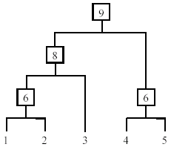
Hierarchical Clustering
Produce a nested sequence of clusters, a tree, also called Dendrogram.

Slide 60
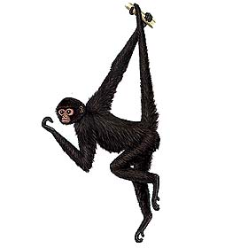
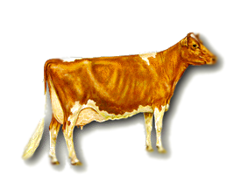
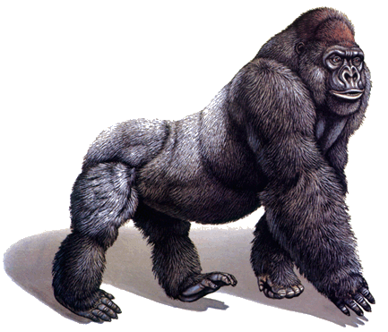
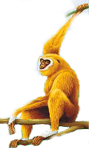
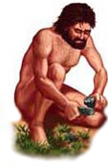
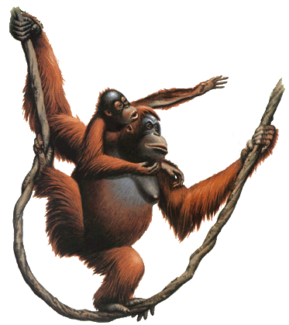
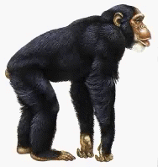
There is only one dataset that can be perfectly clustered using a hierarchy…
(Bovine:0.69395, (Spider Monkey 0.390, (Gibbon:0.36079,(Orang:0.33636,(Gorilla:0.17147,(Chimp:0.19268, Human:0.11927):0.08386):0.06124):0.15057):0.54939);

Slide 61
Types of hierarchical clustering
Agglomerative (bottom up) clustering: It builds the dendrogram (tree) from the bottom level, and
merges the most similar (or nearest) pair of clusters
stops when all the data points are merged into a single cluster (i.e., the root cluster).
Divisive (top down) clustering: It starts with all data points in one cluster, the root.
Splits the root into a set of child clusters. Each child cluster is recursively divided further
stops when only singleton clusters of individual data points remain, i.e., each cluster with only a single point

Slide 62
Agglomerative clustering
It is more popular then divisive methods.
At the beginning, each data point forms a cluster (also called a node).
Merge nodes/clusters that have the least distance.
Go on merging
Eventually all nodes belong to one cluster

Slide 63
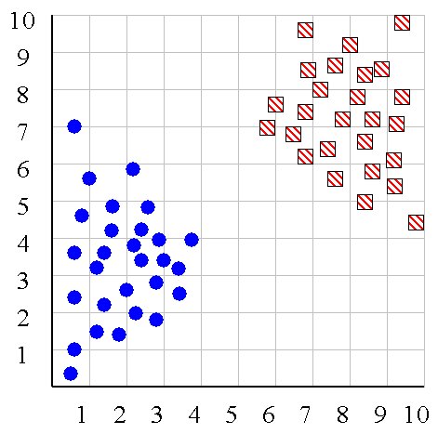
We can look at the dendrogram to determine the “correct” number of clusters. In this case, the two highly separated subtrees are highly suggestive of two clusters. (Things are rarely this clear cut, unfortunately)

Slide 64
One potential use of a dendrogram is to detect outliers
The single isolated branch is suggestive of a data point that is very different to all others
Outlier

Slide 65
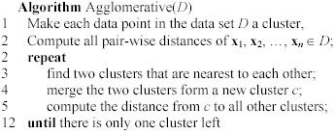
Agglomerative clustering algorithm

Slide 66
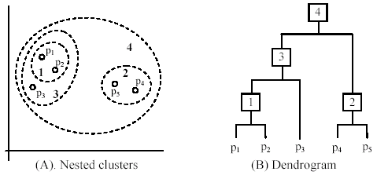
An example: working of the algorithm

Slide 67
Measuring the distance of two clusters
A few ways to measure distances of two clusters.
Results in different variations of the algorithm.
Single link
Complete link
Average link
Centroids
…

Slide 68
We know how to measure the distance between two objects, but defining the distance between an object and a cluster, or defining the distance between two clusters is non obvious.
Single linkage (nearest neighbor): In this method the distance between two clusters is determined by the distance of the two closest objects (nearest neighbors) in the different clusters.
Complete linkage (furthest neighbor): In this method, the distances between clusters are determined by the greatest distance between any two objects in the different clusters (i.e., by the "furthest neighbors").
Group average linkage: In this method, the distance between two clusters is calculated as the average distance between all pairs of objects in the two different clusters.
Wards Linkage: In this method, we try to minimize the variance of the merged clusters

Slide 69
Single linkage
Average linkage
Wards linkage

Slide 70
Summary of Hierarchal Clustering Methods
No need to specify the number of clusters in advance.
Hierarchal nature maps nicely onto human intuition for some domains
They do not scale well: time complexity of at least O(n²), where n is the number of total objects.
Like any heuristic search algorithms, local optima are a problem.
Interpretation of results is (very) subjective.

Slide 71
Density based clustering algorithms
Density based clustering algorithms make an assumption that clusters are dense regions in space separated by regions of lower density.
A dense cluster is a region which is “density connected”, i.e. the density of points in that region is greater than a minimum.
Since these algorithms expand clusters based on dense connectivity, they can find clusters of arbitrary shapes.
DBSCAN is an example of density based clustering algorithm.

Slide 72
DBSCAN (Density Based Spatial Clustering of Applications with Noise)
Published by Ester et. al. in 1996
The algorithm finds dense areas and expands these recursively to find dense arbitrarily shaped clusters.
Two main parameters to DBSCAN are ‘ε’ and ‘minPoints’. ‘ε’ defines radius of the ‘neighborhood region’ and ‘minPoints’ defines the minimum number of points that should be contained within that neighborhood.
Since it has a concept of noise, it works well even with noisy datasets.

Slide 73
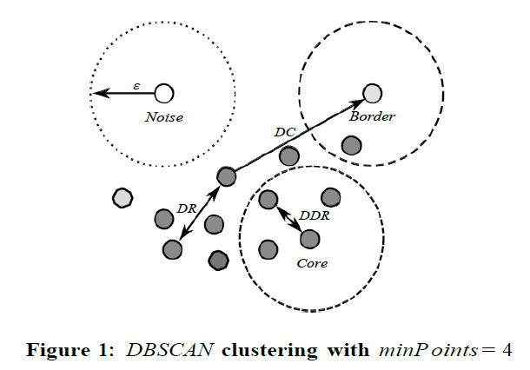
Epsilon neighborhood (Nε) : set of all points within a distance ‘ε’.
Core point : A point that has at least ‘minPoint’ (including itself) points within it’s Nε .
Direct Density Reachable (DDR) : A point q is directly density reachable from a point p if p is core point and q ∈ Nε .
Density Reachable (DR) : Two points are DR if there is a chain of DDR points that link these two points.
Border Point: Point that are DDR but not a core point.
Noise : Points that do not belong to any point’s Nε .

Slide 74
The steps to the DBSCAN algorithm are:
Pick a point at random that has not been assigned to a cluster or been designated as an outlier. Compute its neighborhood to determine if it’s a core point. If yes, start a cluster around this point. If no, label the point as an outlier.
Once we find a core point and thus a cluster, expand the cluster by adding all directly-reachable points to the cluster. Perform “neighborhood jumps” to find all density-reachable points and add them to the cluster. If an an outlier is added, change that point’s status from outlier to border point.
Repeat these two steps until all points are either assigned to a cluster or designated as an outlier.

Slide 75
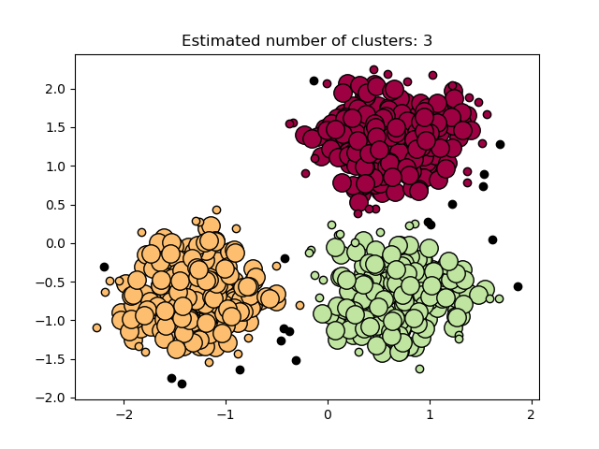

Slide 76
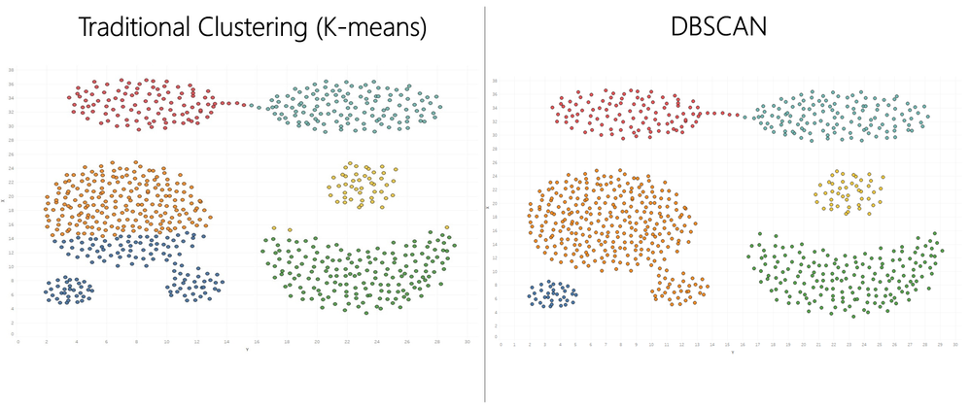

Slide 77

Clustering: sklearn.cluster
https://scikit-learn.org/stable/modules/clustering.html#clustering

Slide 78

https://scikit-learn.org/stable/modules/clustering.html#clustering

Slide 79


